Slide 1
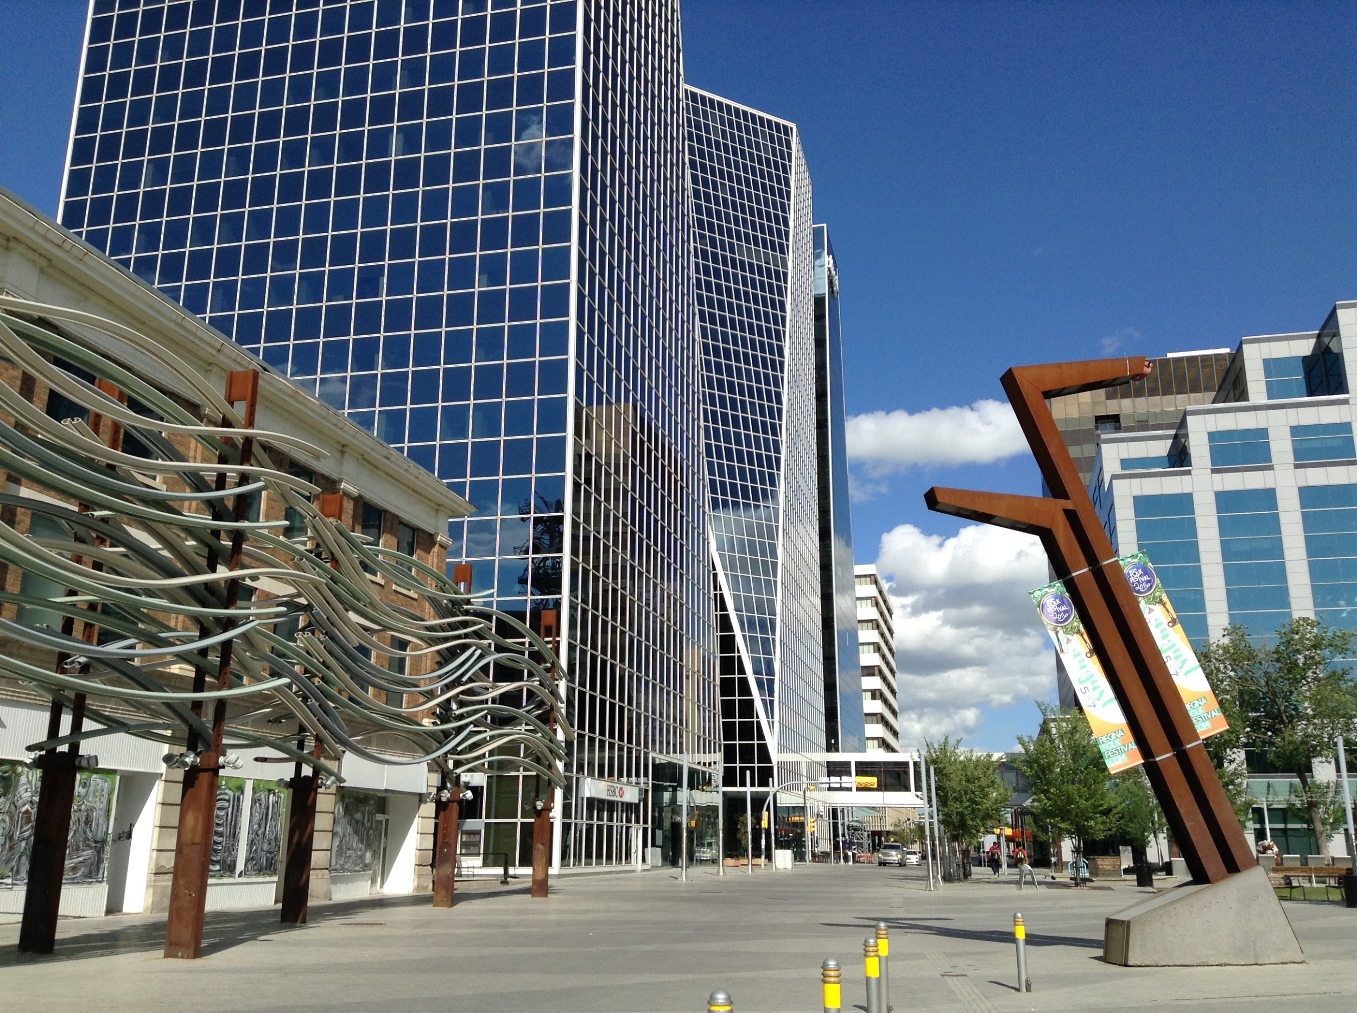
Group I - FirEd
Annoor R., Carter B., Noah R.
4/10/2020

Slide 2

The Problem
For the Regina Fire Protection Services, their current design format for instructing elementary school children on fire safety is relatively outdated.
The instructional session still uses a rotary phone, which is the same as when the activity was created.
The goal given to our group was to create a modernized version of the phone call simulation, ensuring it is more recognizable and familiar for the children using it.

Slide 3
Our Team, Our Goal, & Our Plan
HOW DO WE PLAN TO ACHIEVE THIS?
Our design plan is to make a web-based application, similar to the university’s very own Transit Live.
The reason we’re going to approach it in this fashion is so our application can be saved & ran on any device, and having it as a web-based application will make it so just the webpage is displayed, hiding the google search bar at the top of any device screen.
Additionally, this allows for the website to be downloaded and kept on the phone, to reduce the need for a wifi or data connection.

Slide 4
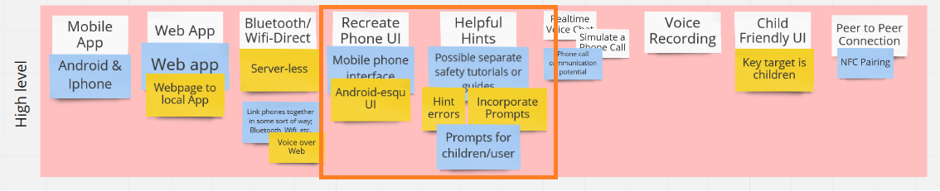
The Framing
Based on empathy mapping for our key customer, these were our main priorities and our vision for the project:
Create an application with the ability to call or simulate a call with a 9-1-1 operator.
Improve the learning experience by integrating prompts or hints into the application, while still remaining familiar to the customer.
The brainstorming process
To come up with this conclusion, we used Candace’s insight and comments after first meeting with our class, and we mapped out priorities with an affinity diagram. The most important priorities being creating a recognizable phone UI, and having hints & prompts.

Slide 5

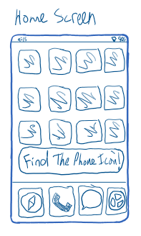
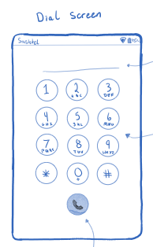
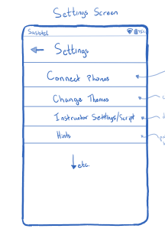
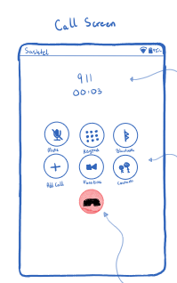
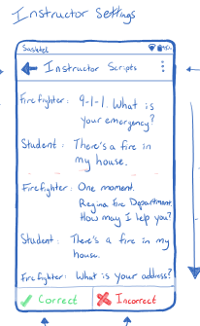
Lo-Fidelity Prototype
During our meeting with the key customer, Candace, we provided our Lo-Fidelity design prototypes to her, some of her insights on our designs after the meeting were the following:
It would be helpful to have hints to inform or teach the kids important lessons for this activity.
Focus on positive reinforcement as opposed to negative reinforcement
Don’t give the users full control over the phone simulation, limit them to only doing the proper actions.

Slide 6

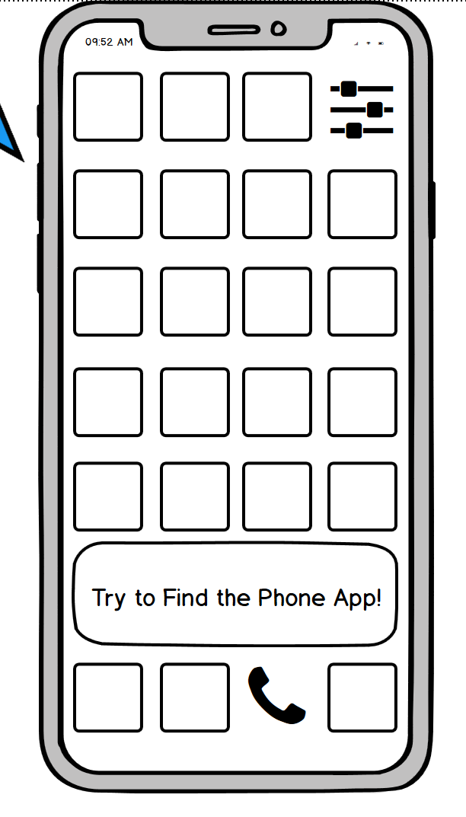
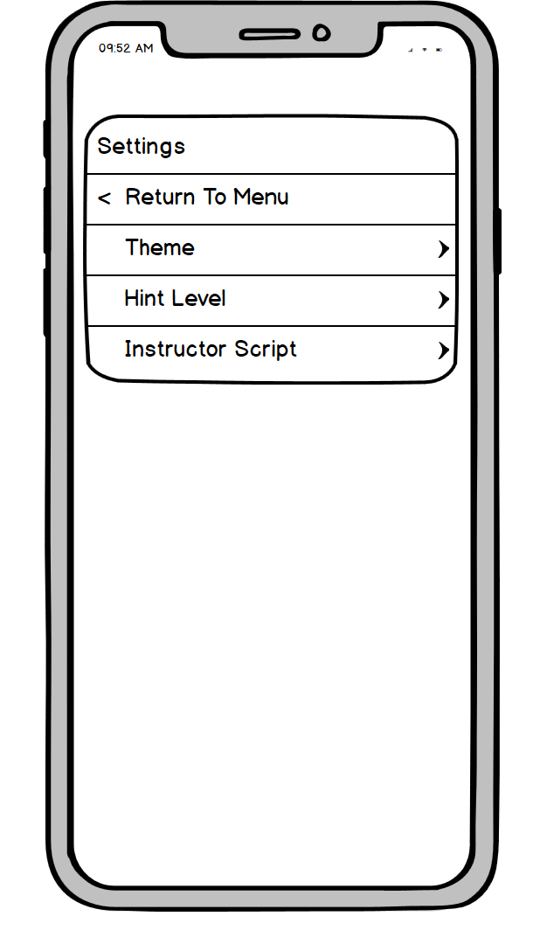
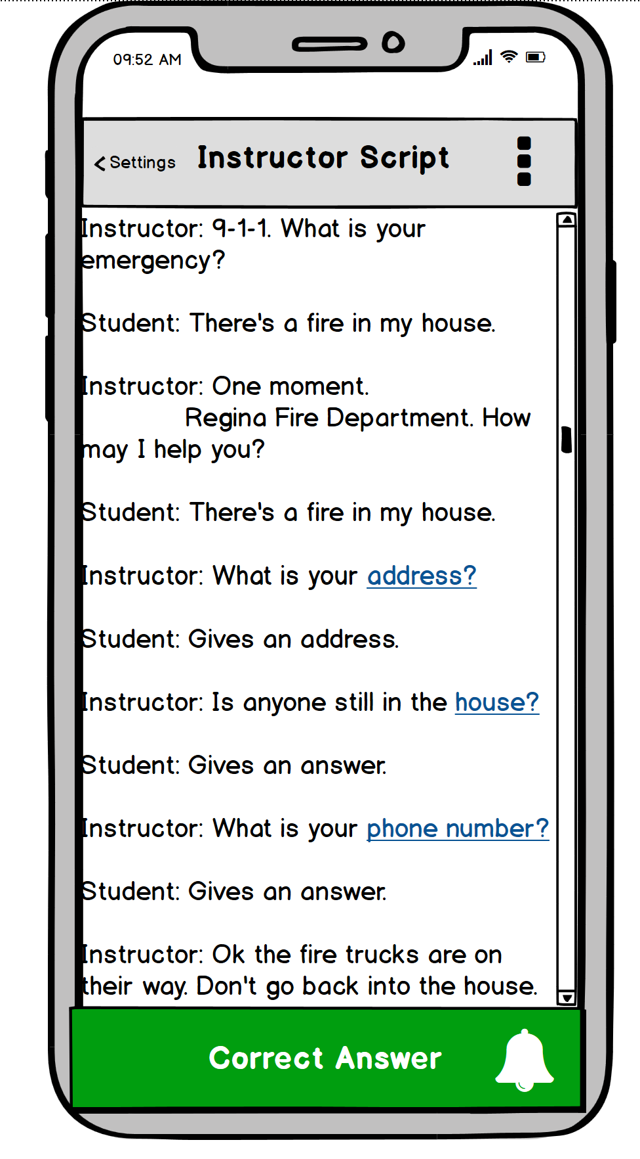
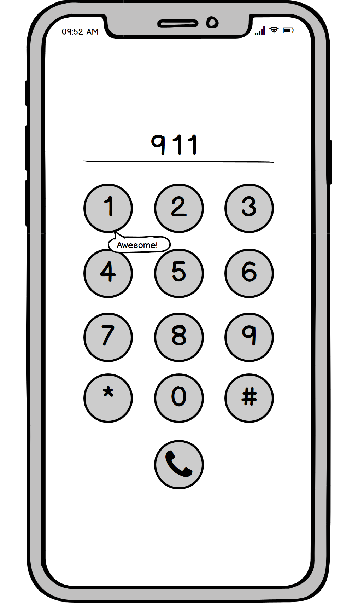
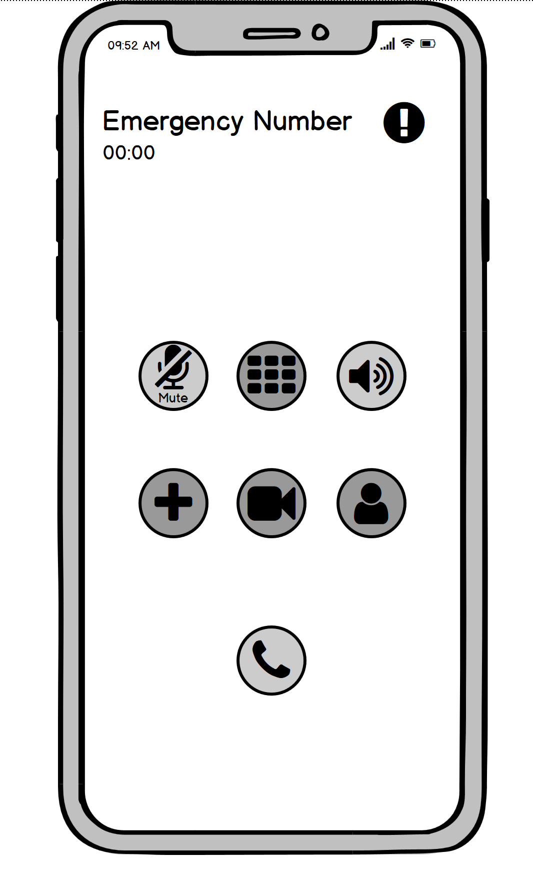
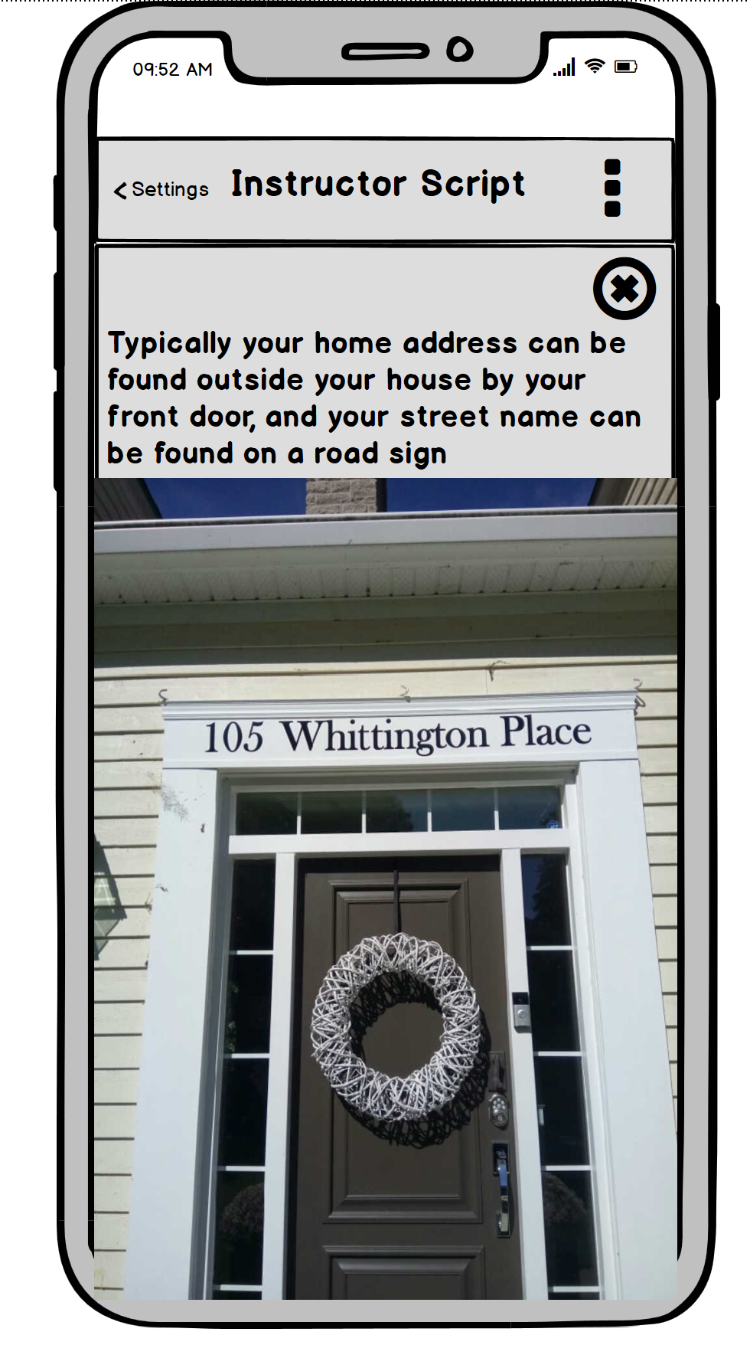
Hi-Fidelity Prototype
During our meeting with the key customer, Candace, we provided our Hi-Fidelity design prototypes to her. We made sure to include and add the recommendations that she had previously asked for from the Lo-Fi prototypes, some of her insights on our designs after the meeting were the following:
Connecting the visuals to a child’s reality is really important for this project
The phone call simulation recreation is the top priority for this current stage of building.

Slide 7
Linking our design to 3 topics discussed in class.
Understandability
Our main priority for this project was to make sure the product is easy to understand for all parties intending to use it.
This follows Gestalt’s principle of easy understandability.
Signifiers
One of the things that we wanted to focus on was drawing the child’s attention to specific parts of our product.
Important areas such as the phone application button and the call/hangup button have different types of signifiers to draw the child’s attention to it. Whether these are hints, arrows, or some other form of indicator.
Constraints
A signifier we included in our product was the use of an interlock setting. What this implies is that when the child clicks a potentially incorrect button, it will give them hints to put them in the right direction.
We only have functionality for the proper buttons, all ‘incorrect’ button presses will result in giving the user a hint.

Slide 8
Our Solution Demo

Slide 9
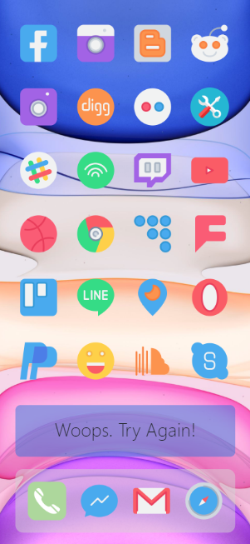
Home Screen
Place your screenshot here
As adapted from our hi-fidelity prototype, the home screen looks reminiscent to that of a common smartphone.
We chose to design it this way so it would seem familiar to kids.
Additionally, we chose for only the phone & settings button to be clickable buttons.

Slide 10
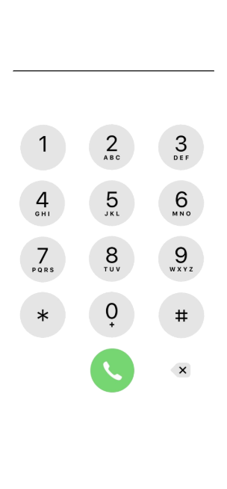
Dial Screen
Place your screenshot here
Remaining within the goal of familiarity, we chose to have a dial screen similar to that of an iphone call screen.
After correctly dialing 9-1-1, the child would begin the phone call simulation after hitting the call button.

Slide 11
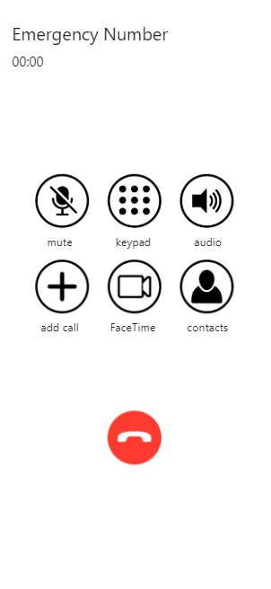
Call Screen
Place your screenshot here
While our call screen isn’t fully developed, we followed the same iphone format to keep familiarity consistent for the children using the application.

Slide 12
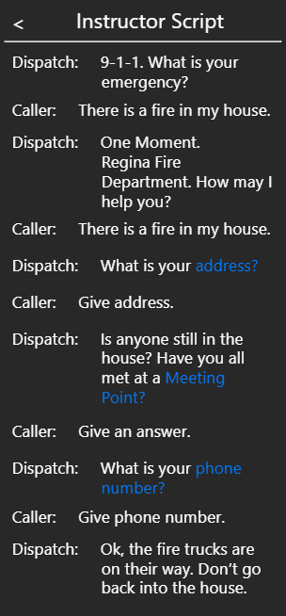
Instructor Script
Place your screenshot here
The primary focus for this project was to emulate a phone call, but we as a group agreed that having the activity script handy would also be an important aspect of this project.
This script includes both the dispatch and the child’s lines for the activity.

Slide 13
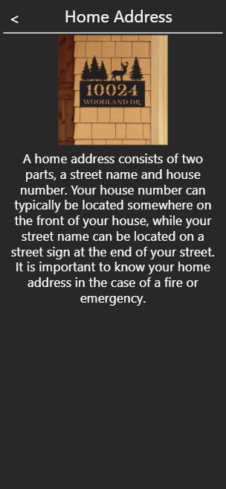
Example Script Link
Place your screenshot here
We chose to include potential hints or explanations for the consumers using the product.
These various hints within the script provide for more information on the questions asked by the dispatch.

Slide 14
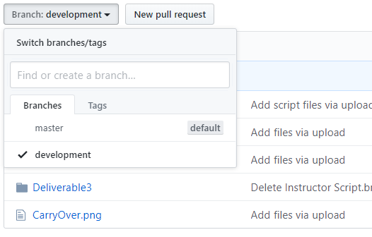
Our GitHub
Place your screenshot here
Our GitHub is up to date and user friendly.
We chose to divide our GitHub into two main components, our master branch and our development branch.
Since our project is still considered to be in the developmental stage, the application files will remain in the development branch and not the master branch.

Slide 15
Group Reflection
How did you feel about this project? What did you like about it? What did you dislike?
We all feel like we were very proud of our final product, we were able to accomplish the majority of what we brainstormed doing in the very first deliverable.
What did you learn about yourself as you collaborated and worked through this project?
We learned about each group member’s individual strengths and weaknesses and catered the project towards them to give us the best possible outcome.
How will you use what you have learned on this project going forward?
We all agreed that having a project situation involving a real customer has prepared us for our future careers. It was very beneficial to have consistent meetings and customer insight on this project, so it will definitely be something we will wish for in future projects.

Slide 16
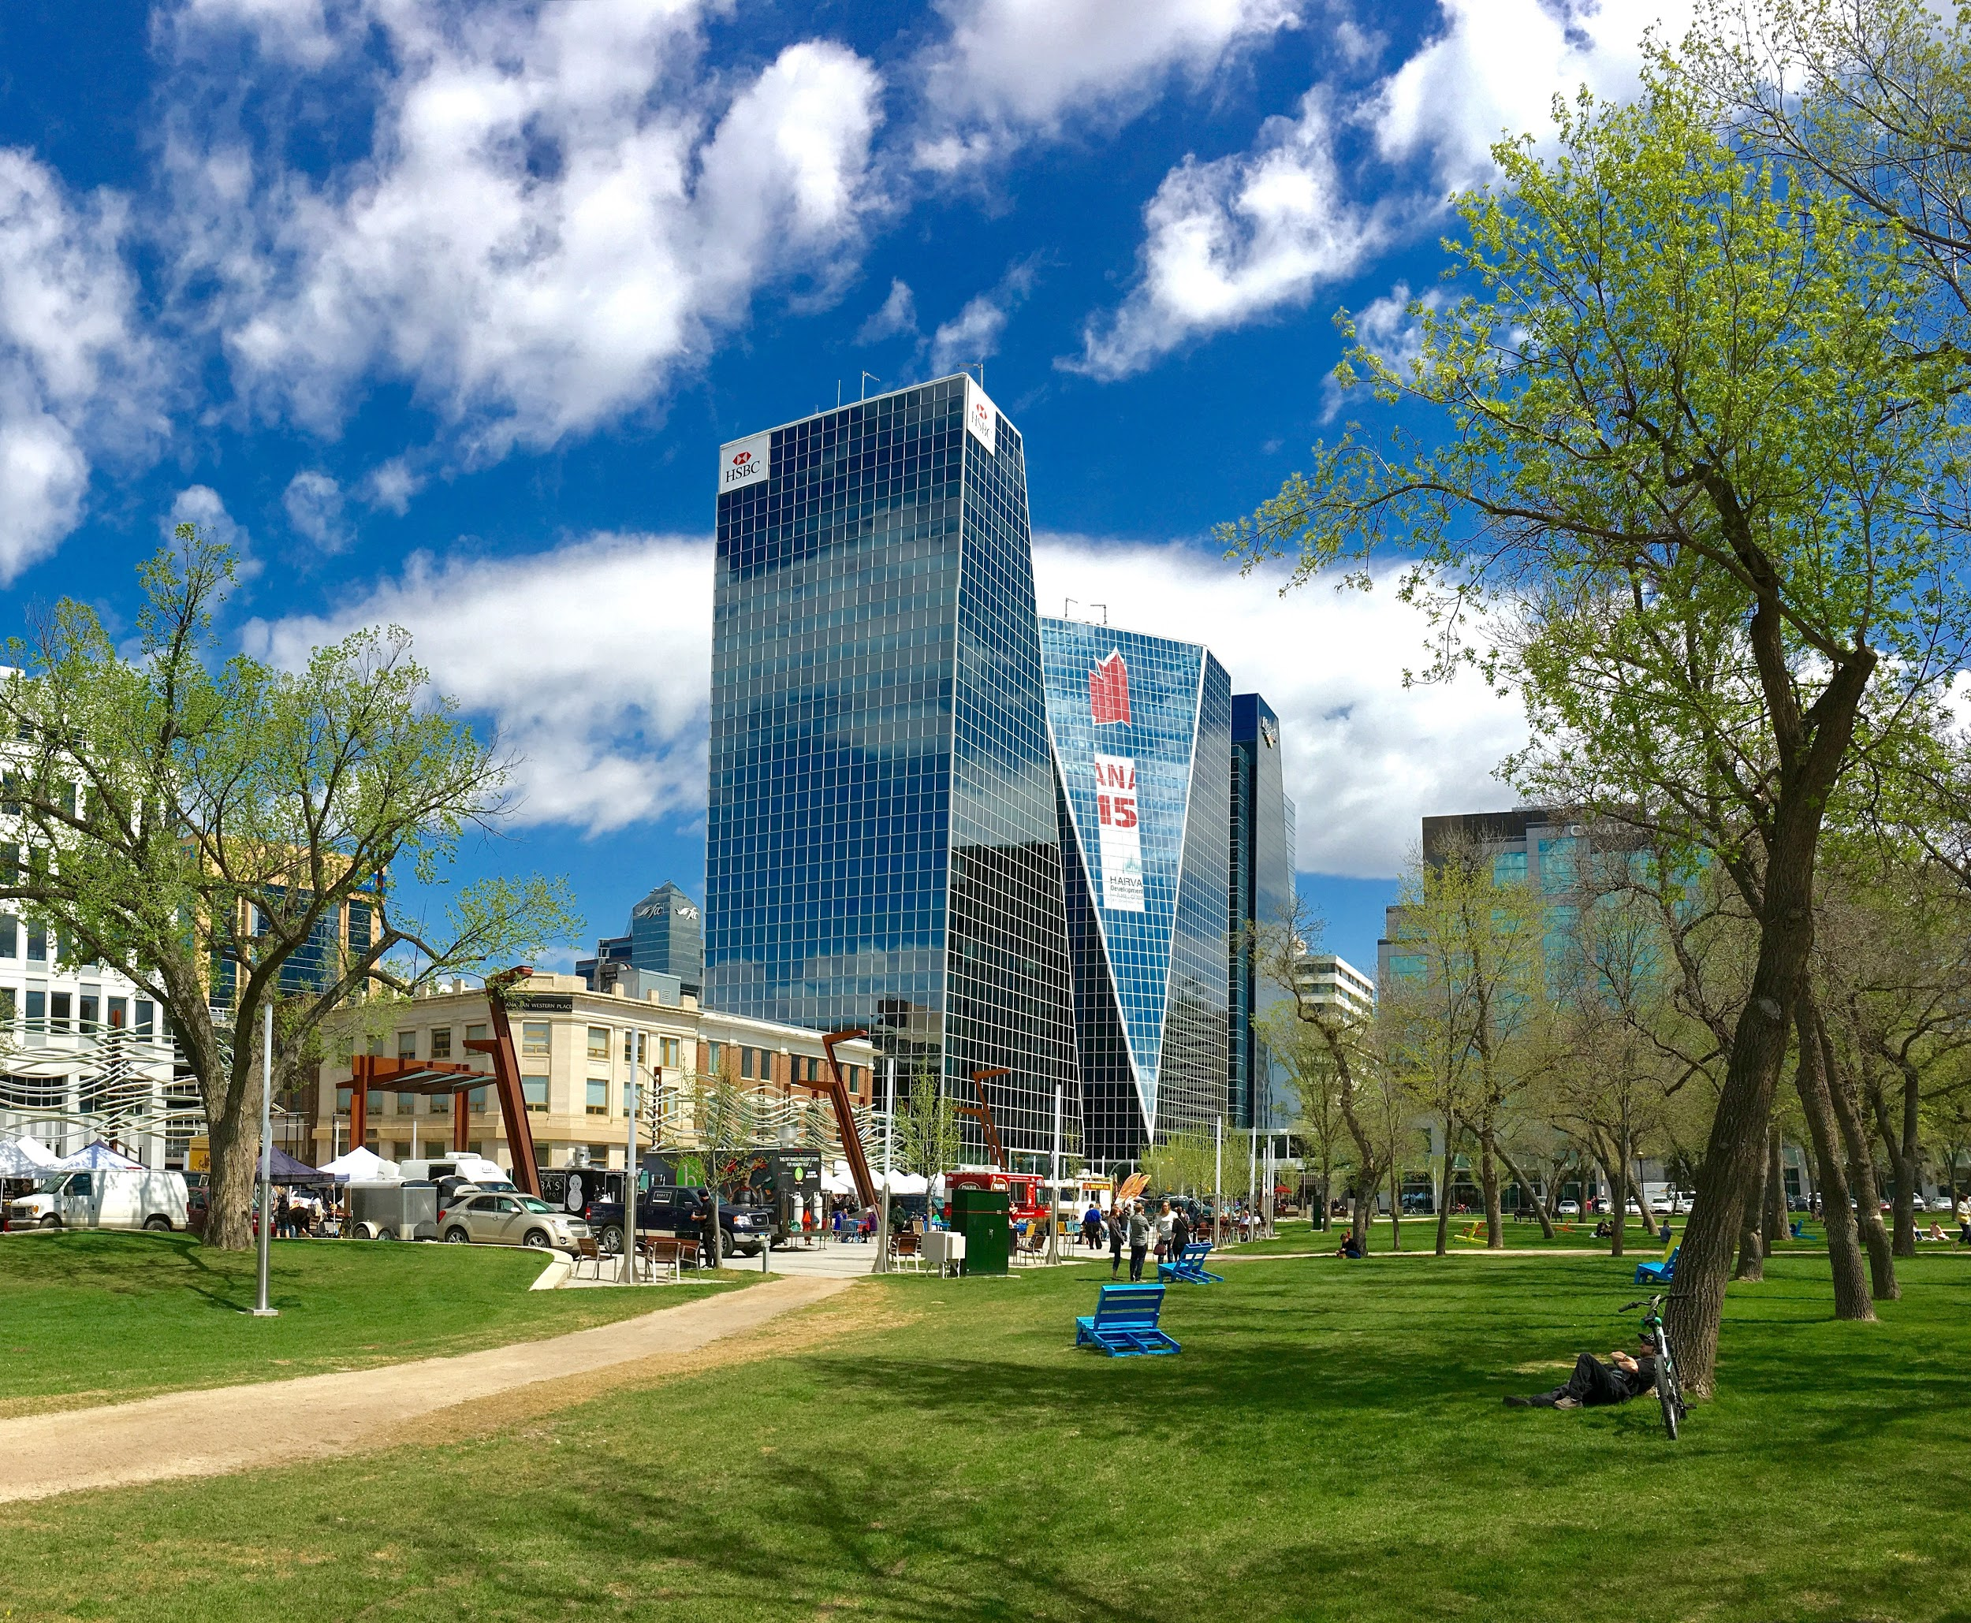
Thank you very much for your time
If you have any questions about our project please don’t hesitate to contact us on URCourses!

